Slide 1
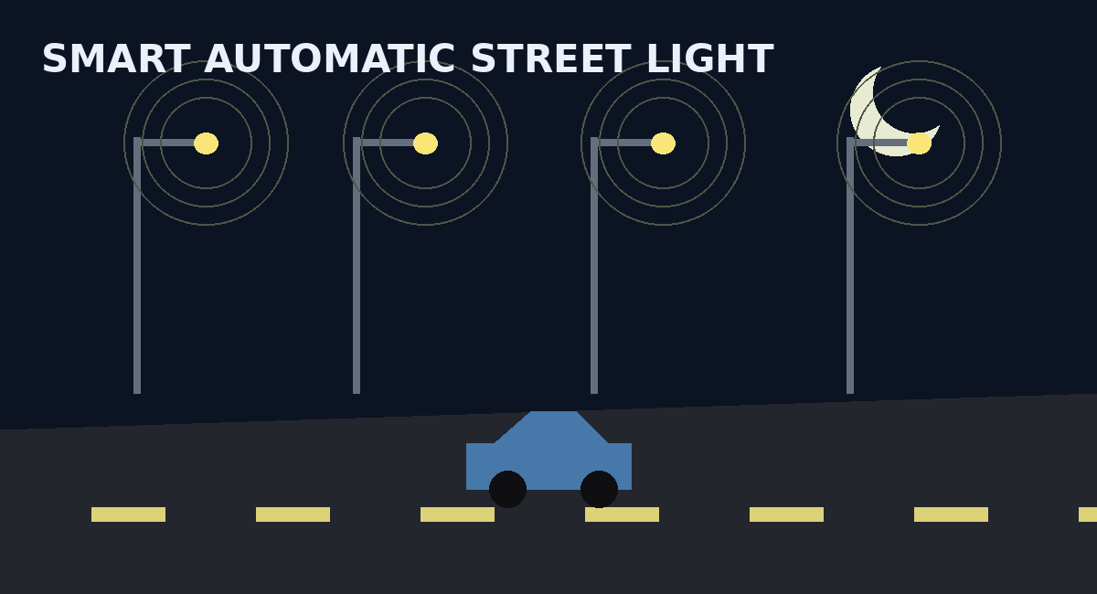
DIGITAL DESIGN & COMPUTER ARCHITECTURE
Design and Simulation of an
Automatic Street Light Control System
Using Combinational Logic
Smart control • Energy efficiency • Safety • Logisim simulation
SRISHOURI THOTTEMPUDI • PRAVEEN KUMAR
PRAVALIKA BODAPATI • PUJITHA VEMULAPALLI
01

Slide 2
01 Project Overview
Source-based abstract translated into presentation form
The proposed system is a smart digital street-light controller that uses multiple input conditions to decide the required lighting response.
• Day/night status
• Vehicle or pedestrian presence
• Emergency condition
• Manual override
• Zone-based activation for reducing power wastage
Combinational logic gates process these inputs and produce optimized control signals.
GOAL
Energy efficiency + road safety
METHOD
Truth table → K-Map → gates
SIMULATION
Test real-world operating conditions in Logisim
02

Slide 3
02 Problem & Objectives
Why automation is useful for street lighting
01
02
03
Reduce wastage
Improve safety
Automate control
Avoid unnecessary illumination when lighting is not required.
Give priority to lighting during emergency conditions.
Replace continuous/manual operation with condition-based logic.
04
05
Control by zone
Build & verify
Activate only the required road section where possible.
Implement the Boolean logic and test it through simulation.
03

Slide 4
03 System Architecture
Inputs → combinational logic → lighting zones
Night / Day
Zone 1 Light
COMBINATIONAL
LOGIC
AND / OR
GATE NETWORK
Smart
lighting
response
Vehicle
Zone 2 Light
Pedestrian
Emergency
Zone 3 Light
Manual Override
04

Slide 5
04 Proposed Boolean Control Model
A clear demonstration equation for the gate-level design
Let N = Night, V = Vehicle, P = Pedestrian,
E = Emergency, M = Manual Override
IMPORTANT
This equation is a proposed simulation model derived from the source requirements; the abstract does not specify one unique Boolean equation.
F = E + N(V + P + M)
F = E + NV + NP + NM
1. OR: V, P, M
2. AND: N with activity request
3. OR: emergency with normal request
4. Output: LIGHT ON
Interpretation:
• Emergency can force the light ON.
• At night, detected activity or manual override can request lighting.
• The expression can be expanded into gate-level AND/OR operations.
05

Slide 6
05 Truth-Table Verification
Representative operating cases for the proposed model
N
V
P
E
M
F
Sample interpretation
Night + vehicle → ON
Night + pedestrian → ON
Emergency → ON
Manual override at night → ON
Day + no demand → OFF
0
0
0
0
0
0
1
0
0
0
0
0
1
1
0
0
0
1
1
0
1
0
0
1
1
0
0
1
0
1
The full design can be expanded to all 2⁵ = 32 input combinations and verified in Logisim.
0
0
0
1
0
1
1
0
0
0
1
1
06

Slide 7
06 K-Map Simplification
N
VP (Gray order)
Reducing the normal night-demand logic before implementation
Example sub-function: G = N(V + P)
00
01
11
10
For the normal lighting path:
G = NV + NP
The K-Map groups adjacent 1s to obtain a compact SOP form.
0
0
0
0
0
1
0
1
1
1
Grouped 1s → NV + NP
Then combine with emergency/manual path to form the complete controller.
07

Slide 8
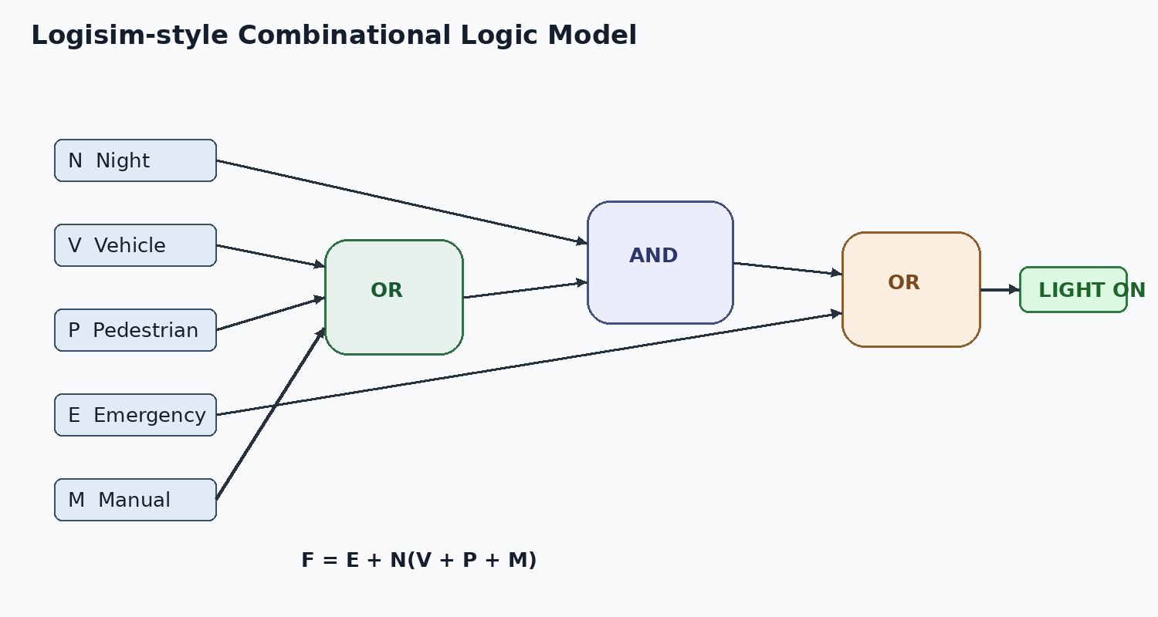
07 Logisim Circuit Design
Gate-level implementation for simulation
08

Slide 9
08 Simulation Scenarios
Real-world operating conditions to verify in Logisim
DAY / NO ACTIVITY
N=0, V=0, P=0, E=0
Lights OFF
NIGHT / VEHICLE
N=1, V=1, P=0, E=0
Relevant zone ON
NIGHT / PEDESTRIAN
N=1, V=0, P=1, E=0
Relevant zone ON
EMERGENCY
E=1
Priority lighting ON
MANUAL OVERRIDE
M=1 at night
Lighting request ON
Verification target: outputs should change predictably when any input condition is toggled.
09

Slide 10
09 Zone-Based & Energy-Saving Operation
Lighting only the required section of the road
ZONE 1
Presence detected
→ zone request
→ light ON
ZONE 2
Presence detected
→ zone request
→ light ON
ZONE 3
Presence detected
→ zone request
→ light ON
→
→
Zone-based control reduces power wastage by activating only the required section rather than illuminating the entire road.
10

Slide 11
10 Conclusion & Team
Practical DDCA application
The project demonstrates how DDCA concepts can be applied to a practical street-lighting problem:
• Combinational logic for decision making
• Truth tables and K-Maps for Boolean simplification
• Gate-level circuit design
• Logisim simulation and verification
• Energy efficiency and safety through conditional control
CREATED BY
SRISHOURI THOTTEMPUDI — 2620030041
PRAVEEN KUMAR — 2620030030
PRAVALIKA BODAPATI — 2620030029
PUJITHA VEMULAPALLI — 2620030051
SCALABLE SYSTEM DESIGN
The source highlights pedestrian detection, vehicle detection, safety enhancement, power optimization, and scalability.
THANK YOU
11

